Slide 1



Digital Mapping
Welcome to a short presentation on how to create a very basic event route using digital mapping. In this example, we will be using Quo by Mapyx Limited Digital Mapping Solutions.
www.mapyx.com

Slide 2

Here is a typical view of Quo when you open the application.
The Ordnance Survey maps (or Tiles) can be purchased and downloaded from the ‘Tile Shop…’ icon located at the top right of the screen. Please note that once the maps have been purchased and downloaded, they remain in Quo for as long as you need them.

Slide 3
When accessing the Tile Shop, the map will divide into squares which are called ‘Tiles’, and the ‘Tile Shop’ window will appear on the screen ready for you to make your selections.

Slide 4
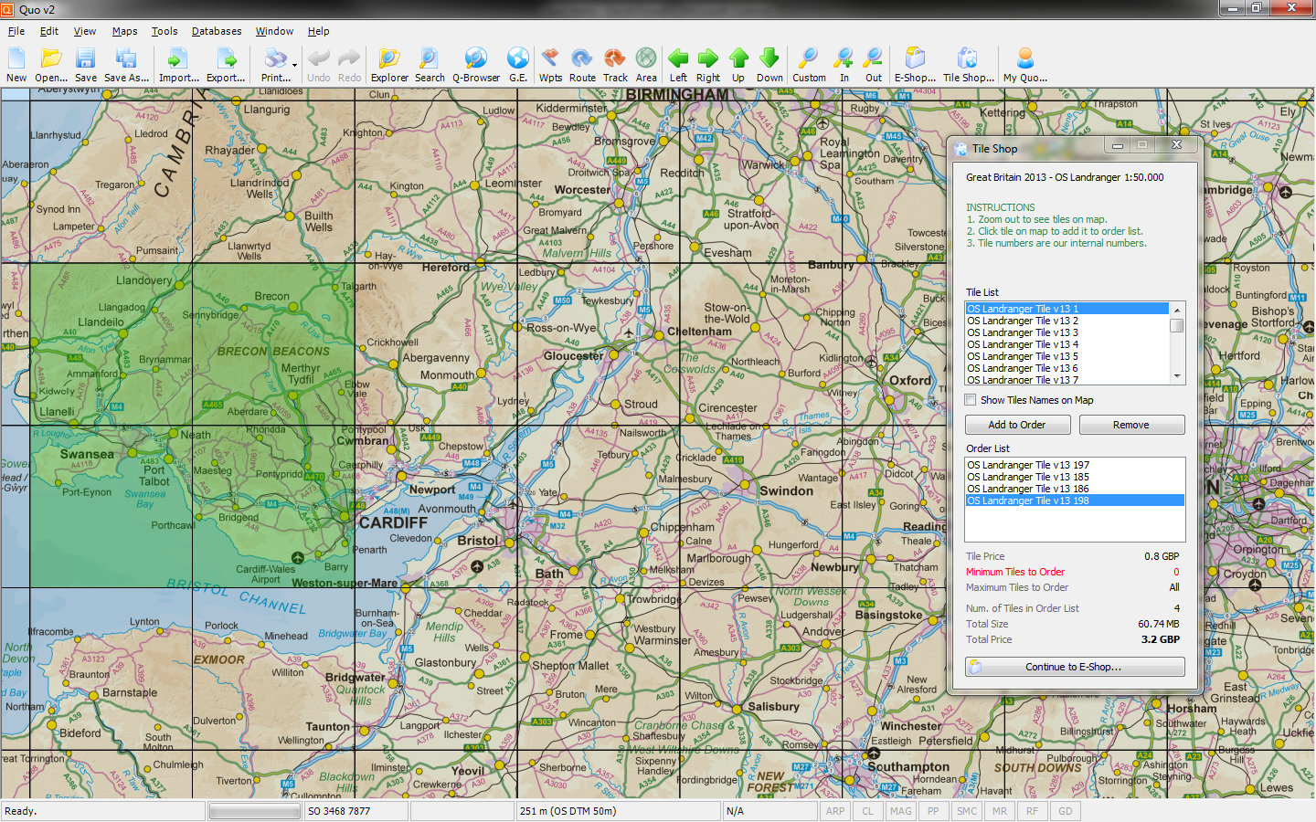
Click on the map squares to select the required Tiles (highlighted in green), then select ‘Continue to the E-Shop…‘ to purchase the Tiles. You may need to create an account with Mapyx to complete this process.

Slide 5
When the maps are loaded, move to the area of map required. To navigate around the map, use the left or right-mouse button to pan, and the mouse wheel to zoom in and out. Ensure the Project Explorer is open by selecting the icon at the top of screen. You can also move around the map and zoom in and out by using the navigational icons at the top of the screen.

Slide 6
We need to give our route a name, so select ‘Save As..’ and type in the event title. Select ‘Save’ (as a .qu2 file) when ready. Remember to ensure you save in a location you can find it. In this example, we are using the ‘desktop’ as our save location.

Slide 7
The project name now appears in the top left corner of the screen.

Slide 8
We can now begin creating our route by selecting the ‘Track’ icon at the top of the screen. A new Track (Track 1) will show on the Project Explorer.

Slide 9
Take your mouse cursor to the Start point of your route and click on the road to begin. You will see a black information box appear next to the cursor which will show details of your route.

Slide 10
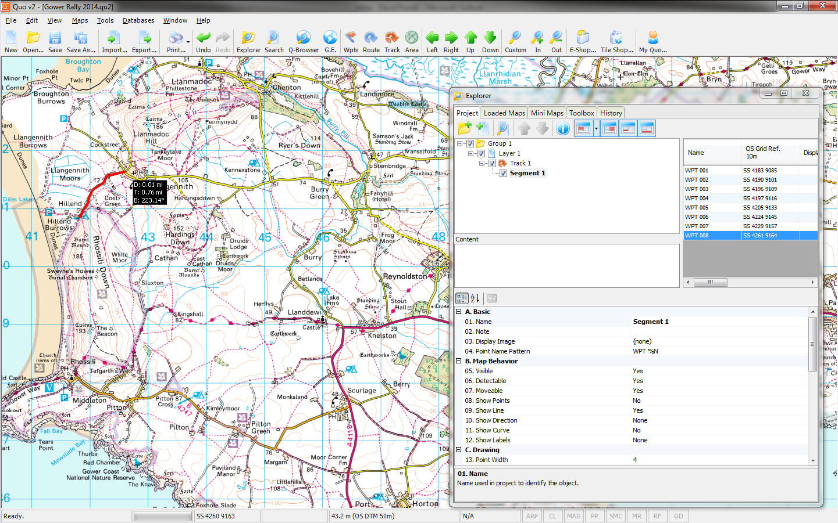
Construct your route section by one of two methods: -
1 – Hold the left mouse button and draw the Track along the road.
2 – Use the left mouse button to click on the road at small intervals to build up the Track.

Slide 11
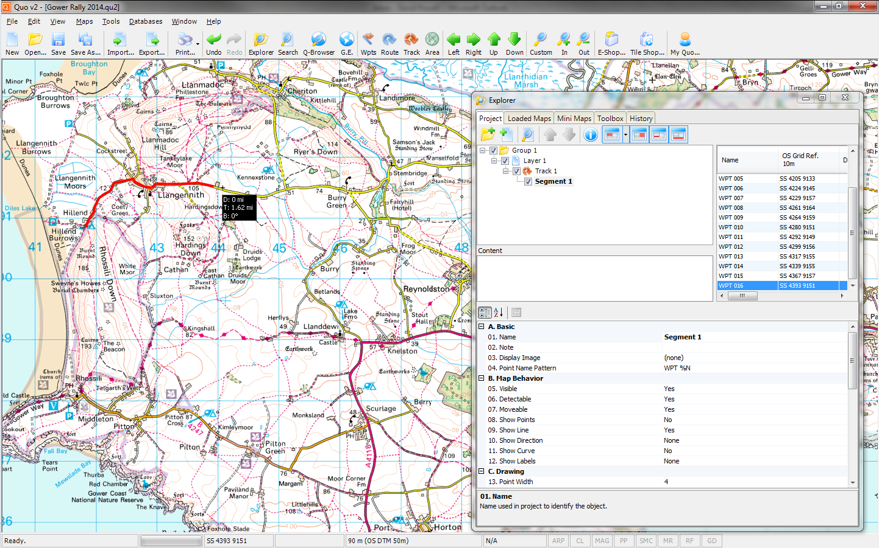
Construct your route section by one of two methods: -
1 – Hold the left mouse button and draw the Track on the road.
2 – Use the left mouse button to click on the road at small intervals to build up the Track.

Slide 12
Construct your route section by one of two methods: -
1 – Hold the left mouse button and draw the Track on the road.
2 – Use the left mouse button to click on the road at small intervals to build up the Track.

Slide 13
When your Track is finished, Right-click the mouse and select ‘End Segment’.
The Information box will shows the current distance of the Track.
In the example above, the distance is exactly 2 miles.

Slide 14
Small mistakes can be corrected by right-clicking and selecting ‘Delete Last Point’. This can be repeated right back to the start of your Track if required. To completely remove the Track, click on the Track in the top Explorer panel and use the Delete key on your keyboard.

Slide 15
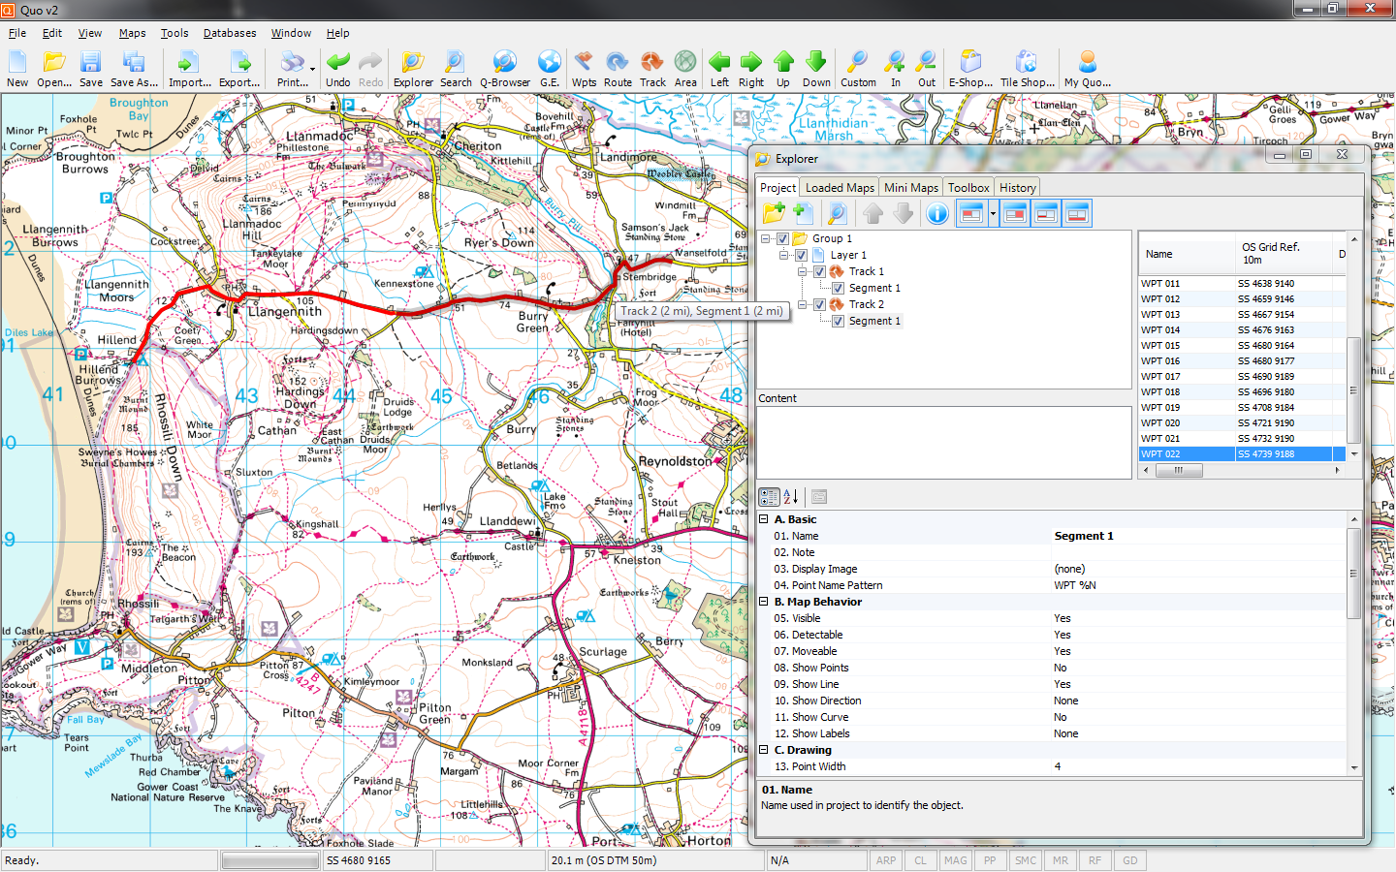
We create our next section by again selecting the ‘Track’ icon at the top of the screen (which gives us ‘Track 2’ in Explorer) and constructing it on the road exactly as before. We started ‘Track 2‘ at the point where ‘Track 1’ ended.

Slide 16
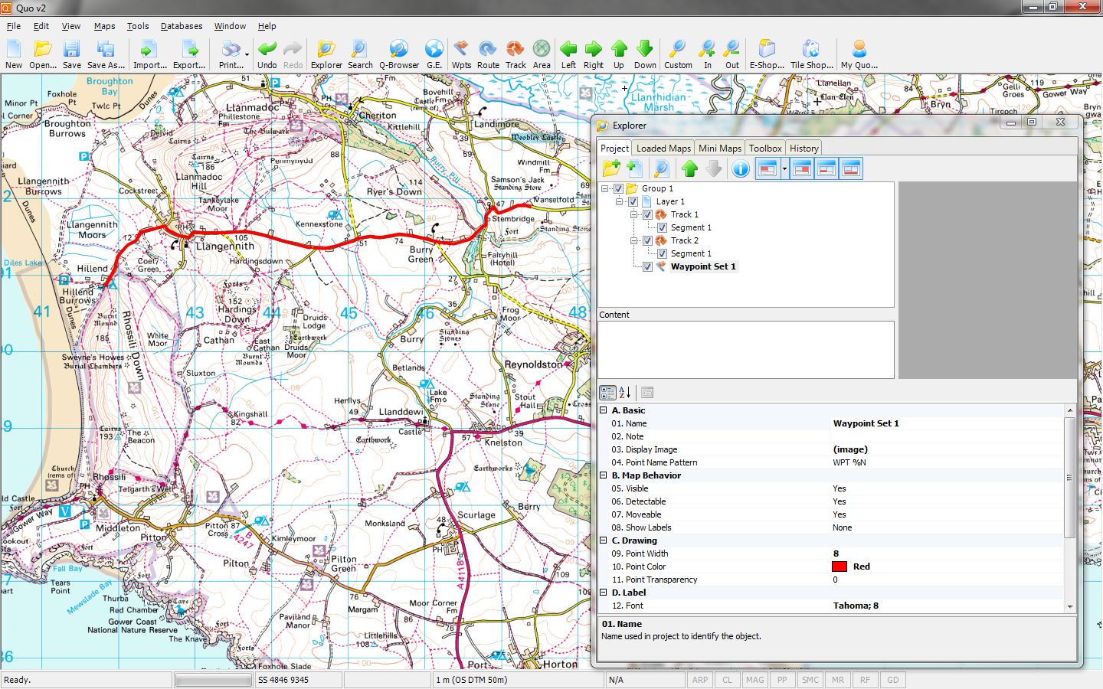
Next, we are going to insert our Control Point locations. We use Waypoints by selecting the ‘Wpts’ icon at the top of the screen. Note that Waypoint Set 1 has now appeared in our Explorer.

Slide 17
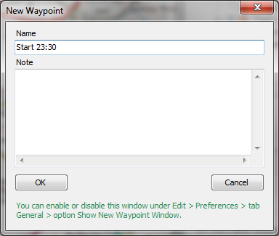
Enter the required text into the Name field (e.g. the Control Point reference and Time), then select ‘OK’ to proceed with the next point. When finished, right click the mouse and select ‘End Waypoint Set’

Slide 18
Our control points are now on our route marked as red squares (by default). You can also see our waypoint information shown in the right-hand panel of our Explorer.

Slide 19
We now need to tidy-up our project and get the control point text to show on the map. This is all done in our Explorer.

Slide 20
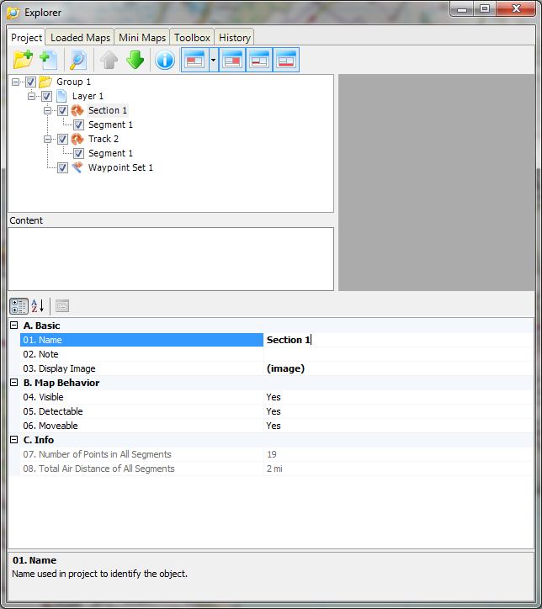
Click on the Track in the top Explorer panel, then rename it by clicking on ‘01. Name’ in the lower panel and typing the new name. We are calling it ‘Section 1’ in this example.
Repeat this for the other Tracks and Waypoint Sets.

Slide 21
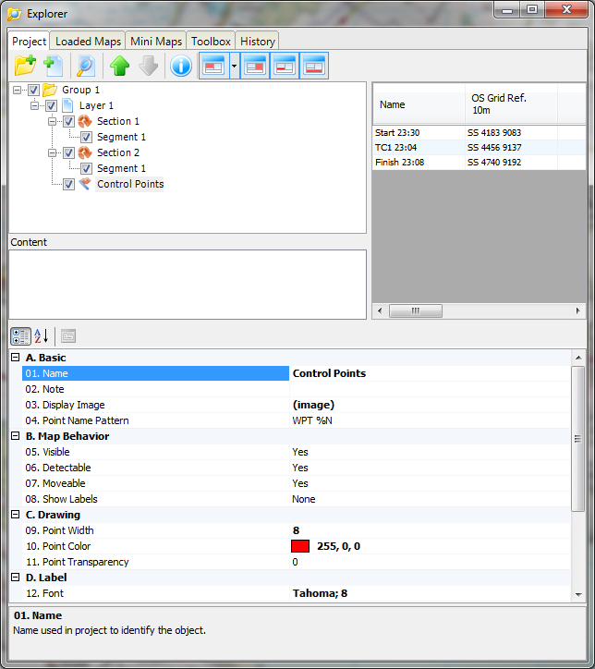
We can now see the Tracks renamed to ‘Section1’ & ‘Section 2’, and the Waypoint Set 1 renamed as ‘Control Points’.

Slide 22
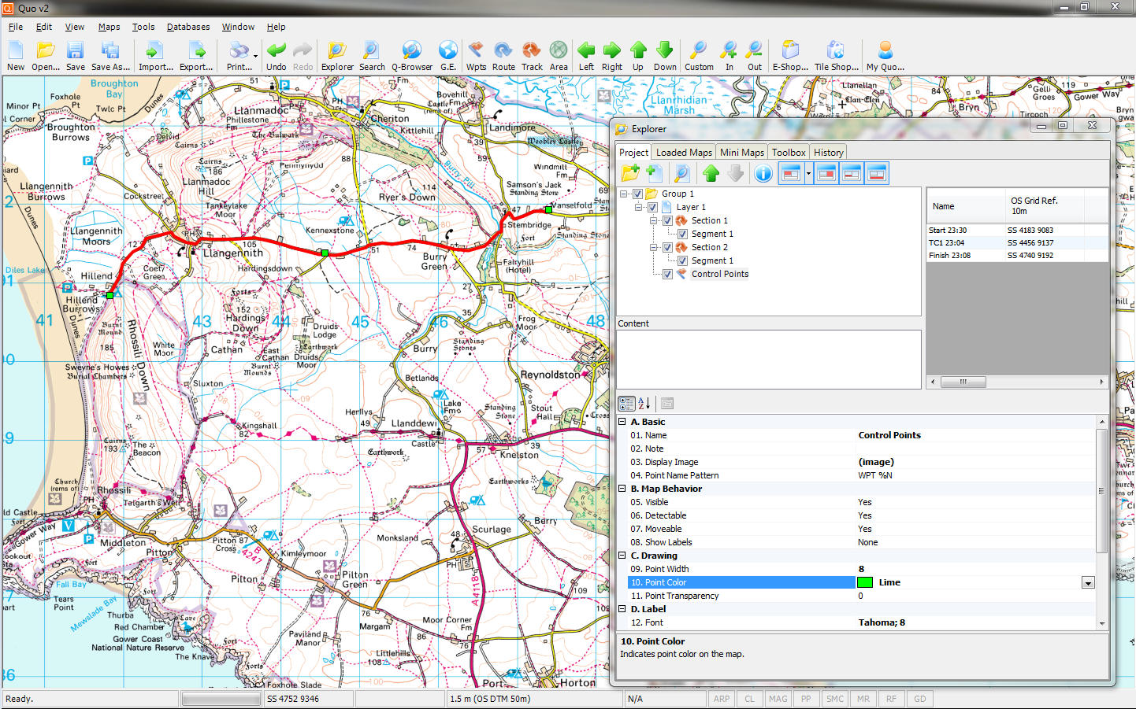
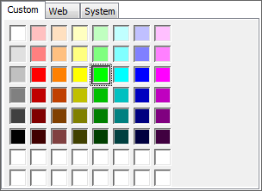
Now to change the colour of our control points. Select the ‘10. Point Color‘ arrow and click on your preference. Green gives a nice contrast to the red Track and yellow road.

Slide 23
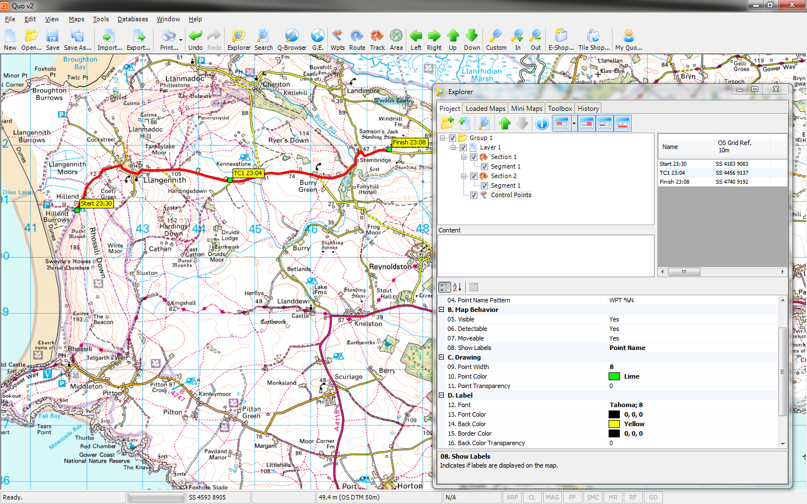
We have now added the text to the control points by amending ‘08. Show Labels‘ to Point Name, and ‘14. Back Color‘ to Yellow (again, to add a nice contrast).

Slide 24
Don’t forget to use the ‘Save…’ icon at the top of the screen to save your project at regular intervals to ensure you don’t lose your progress. This is especially important when creating routes for large events.

Slide 25
To print our route, click on the ‘Print…’ icon at the top of the screen. When the Print window appears, ensure you select ‘Empty (Single Page)’ for Project. The scale is usually set at 1:50,000, but can be changed to suit the size of the route.

Slide 26
Ensure the correct orientation (Portrait or Landscape) is selected, and add text to the Headers and Footers; such as the club name, event name and scheduled dates. When you are happy with your settings, select ‘Next’.

Slide 27
The shaded rectangle represents the area of the map that will be printed. This area can be moved around the map by clicking and holding the left mouse button.

Slide 28

For larger routes, additional pages can be added by clicking the ‘Add Page’ icon on the small print window (Ensure to uncheck the ‘Move All Pages’ box at the bottom of the window).

Slide 29
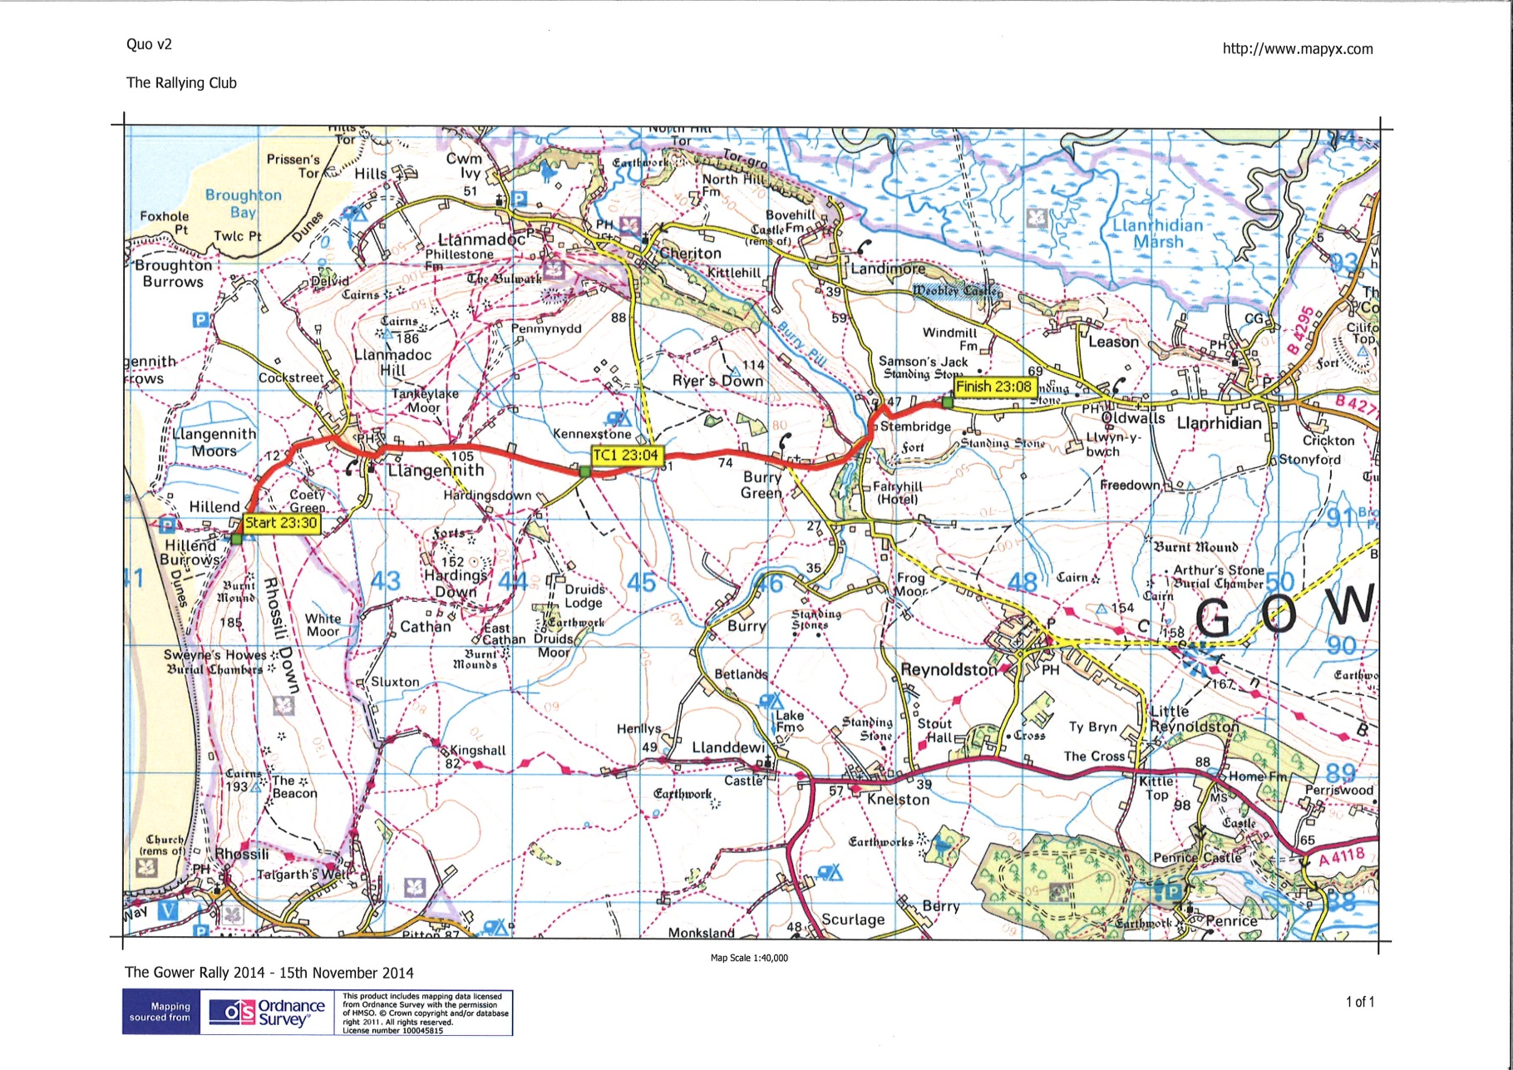
And here is how the printed version of this example looks.
Thank you for your attention, and we hope this provided some assistance in basic route creation. However, please feel free to experiment and find ways that are more suited to your own needs and skills, or contact the CAO office for more information.

Slide 30
Frequently Asked Questions.
Q: Where Can I Get Quo?
A: Direct from the Mapyx website: https://www.mapyx.com/quo/download.asp
Q: How much does Quo cost?
A: Absolutely Nothing. Quo is a free-to-download application
Q: How big are the Tiles in area?
A: Each 1:50,000 scale Tile covers 40km x 40km
Q: How much are the Tiles?
A: At the time of writing, Tiles cost 85p each + VAT (£1.02 Inc. VAT).
Larger areas are also available from the Mapyx website at lower prices.
Please refer to the Mapyx website at www.mapyx.com for the latest prices and information.
Q: What System Requirements do I need to run Quo?
A: Microsoft Windows XP, Vista, 7, 8, 10. 300Mb of Disk Space, 512Mb of RAM. Quo is NOT available for Mac.
Q: What happens if my computer crashes and I lose all my maps?
A: Send an email to info@mapyx.com requesting a download link to retrieve all the maps you lost.
Q: How do I contact the Motorsport UK CAO Office for further assistance and information?
A: By telephone on 01753 765075. By email on cao@motorsportuk.org

