Slide 1
Motorsport UK – Safeguarding Induction Pack for Clubs

Slide 2
Introduction
Welcome to your Safeguarding induction.
At our Club, the safety and wellbeing of all Club members is our top priority. We all have a responsibility for safeguarding and together we can help to create a safe, fun, fair and inclusive sport.
Why are we doing this?
Improve awareness and training
Strengthen our reporting procedures
Embed safeguarding into our everyday practices
Promote Race with Respect values and code or conduct

Slide 3
What is Safeguarding?
Safeguarding means protecting people from harm, mitigating risk and creating a safe environment for everyone. It is important to keep everybody safe, but particular focus should be placed on those who are more vulnerable:
Children (anyone under 18 years old)
Adults at Risk – a adult with additional needs, who may be at risk of harm or exploitation.
In motorsport, this means:
Spotting when something doesn’t feel right
Knowing who to speak to if you have concerns
Taking appropriate action to keep people safe and prevent harm

Slide 4
Safeguarding in Motorsport
Motorsport is a fast-paced, exciting and sometimes high-pressure environment. Children and young people look up to adults, volunteers and officials. That trust brings responsibility. A strong safeguarding culture within our Club makes motorsport better for everyone.
We must make sure that:
Everyone feels safe and respected
Bullying or abuse is not tolerated
Concerns are reported and taken seriously

Slide 5
Types of Abuse
Knowing the different types of abuse can help you to stay alert and recognise when something is not right. If something doesn’t feel right, it is important that you report your concerns to the Club Safeguarding Officer.
Physical Abuse
Emotional Abuse
Sexual Abuse
Neglect
Bullying
Causing injury or pain
Unexplained bruises
Bleeding
Burns
Cuts
Threats
Shouting
Excessive pressure
Contact
Non-Contact
Comments
Harrasment
Not meeting a person’s basic needs
Self-neglect
Repeated unfair treatment or harmful behaviour towards a person
Cyber-bullying

Slide 6
Recognising Early Signs
Spotting the signs that person may be being harmed early can help to prevent further harm from occurring.
Look out for:
Changes in a person’s behaviour
Avoiding certain people or places
Nervousness or withdrawal
Fear of a person or place
Unexplained injuries
A child or adult at risk saying something worrying
You don’t need to have all the answers, but you do have a duty to report anything that doesn’t feel right.

Slide 7
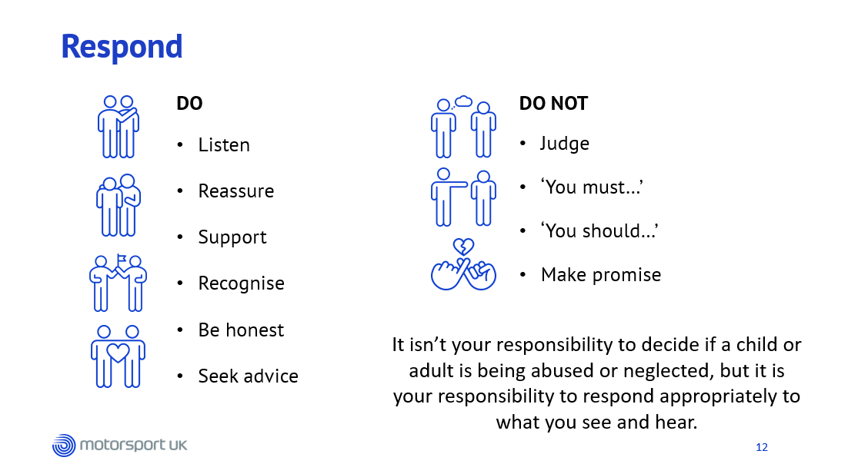
Notes:
Every person and situation will be different, have different levels of risk and require a different response – colleague reporting 10 years of domestic abuse or a child with concerns about online behaviours.
Important that we use open questions, listen carefully to understand the risks to them and those around them and we understand what outcome they want to see.
Victim-focussed – where possible we do what the victim wants to happen rather than what we think should happen.

Slide 8
Reporting
If you become aware of something that concerns you, you must report this through one of the below channels.
Club Safeguarding Officer
Name –
Email –
Phone Number -
Motorsport UK Safeguarding Team
safeguarding@motorsportuk.org
Online reporting form
01753 765 000
If there is an immediate risk of harm
Call 999

Slide 9

Race with Respect
The National Governing Body’s Respect Code champions a high standard and expectations from everyone within the motorsport community underpinned by our commitment to make motorsport an inclusive and safe sport for everyone, across all levels of motorsport.
The Respect Code will help to grow and strengthen the sport by making it accessible and welcoming for everyone and we cannot stress enough how important it is that it is embraced by all participants.
By participating in a Motorsport UK event, in any capacity, you are agreeing to follow the values of the governing body’s Respect Code:
Respect
Integrity
Fair Play
Self-Control
Good Manners

Slide 10
Your Role in Safeguarding
Every Club member, volunteer and official has a role to play in creating a positive safeguarding culture:
Recognise signs of harm
Be approachable and kind
Create a positive and welcoming environment
Follow the Race with Respect code of conduct
Know how and where to report your concerns
Every action helps to build a safer motorsport culture.

Slide 11
Further Help and Resources
If you or anyone you know needs any further support, this can be found through one of the below organisations:
Mind – www.mind.org.uk
0300 123 3393
NSPCC – www.nspcc.org.uk
0808 800 5000
Young Minds – www.youngminds.org.uk
Samaritans – www.samaritans.org
The Safeguarding Team at Motorsport UK can assist in locating other organisations if this is needed.

Slide 12
Further Support and Training
If you would like to know more about keeping children and young people safe, further resources and guidance can be found below.
National Society for the Prevention of Cruelty to Children (NSPCC)
For advice on children’s mental health, staying safe online, support for parents and more.
https://www.nspcc.org.uk/keeping-children-safe/
Child Protection in Sport Unit (CPSU)
Working to improve safeguarding and child protection practices within sports organisations, to ensure all children are safe when participating in sport and physical activity.
https://thecpsu.org.uk/help-advice/

